Slide 2
Application Lifecycle Management for Power Apps
Ankit Girgas & Vishal Gurav

Slide 3
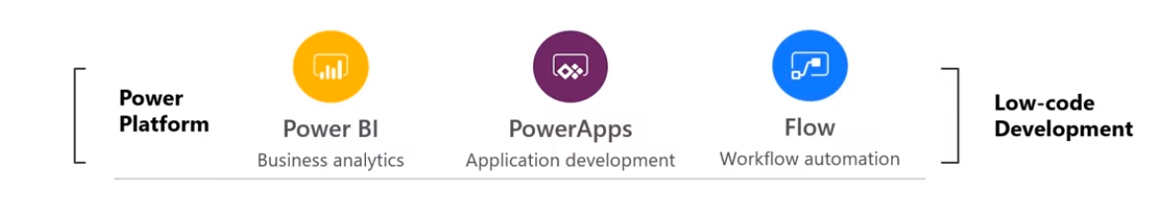
Power Platform Enables Digital Transformations
Notes:
Empowers employees
Engage Customers
Optimize Operation
Transform products
However it comes with major risk as well. If Power Platform lacks the good governance, it will fail badly.
Hence, lets discuss first thing first

Slide 4
Business Case
Vehicle Inspection

Slide 5
Vehicle Inspection
Objective:
Vehicle Inspection should happen through mobile app and should be performed by vehicle driver.
App should capture the vehicle photos with time stamp.
App should work in offline mode and should sync the data automatically once in the data network.
Current Challenges:
The uploaded data has lots of human errors.
The data upload and processing is delayed by 3 days.
Notes:
Company has multiple plants and transport vehicles operating 24x7 in multiple shifts.
Each vehicle gets inspected when the driver is changing the shift
Data collection is performed on paper which then gets uploaded along with photos to OneDrive.
The monthly report is generated to observe the vehicle scheduled maintenance and the fitness.

Slide 6
Before building…
Container/Environment
App Layout
Template
Data Policies
Configuring User Access
Testing
Packaging
Deployment

Slide 7
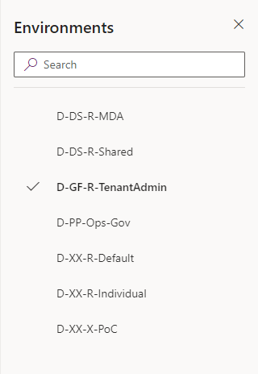
Environment is Container
Container for PowerApps
Contains PowerApps and Flows
Represent the logical/virtual separation between different environments (DEV/UAT/ PROD)
Represents the governance and security boundaries
Every tenant is contains a default Environment which can’t be removed
Admin can create new Environment (with or without database)
Notes:
When environment contains the database the security model changes.

Slide 8
Environment classification
Production – Used for permeant work in an organization
Default – Special type of production environment.
Can’t be deleted
Automatically adds all tenant users in maker role which can’t be removed
Provides self service app to all licenses users
Sandbox – Non-production environment with environment reset feature
Trial – Temporary environment used to support short term testing
Developer – Environment created with the community plan license, supports single user

Slide 9
Environment Security
Environment Admin – Can perform all administrative actions on environment
Add remove users
Create CDS data base instance
View and manage all resources
Delete, export Canvas app
Configure DLP (data loss prevention) policies
Environment Makers – Can create new resource in an environment
Create, share canvas app and flow
Create, share connection and custom connectors
Notes:
Creating the CDS database changes the security model
CDS database model is required for Model Driven Apps

Slide 10
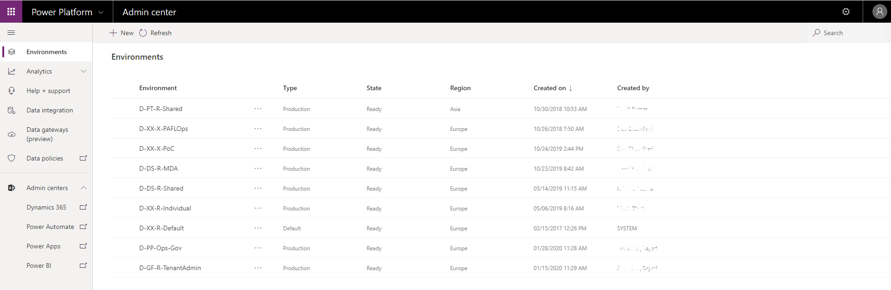
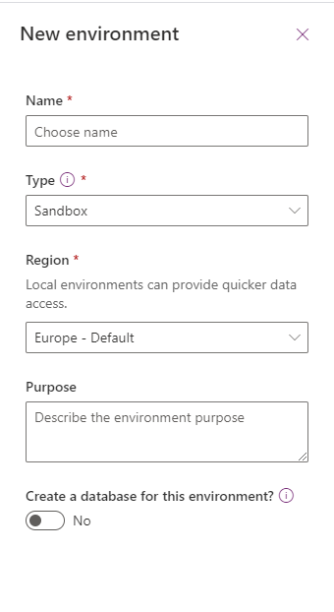
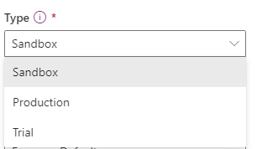
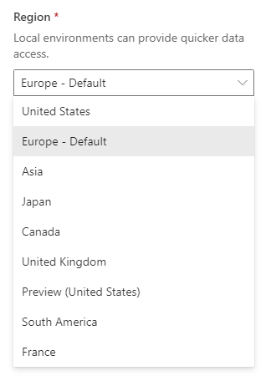
User Location
Data Residency

Slide 11
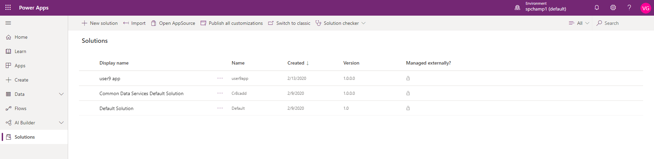
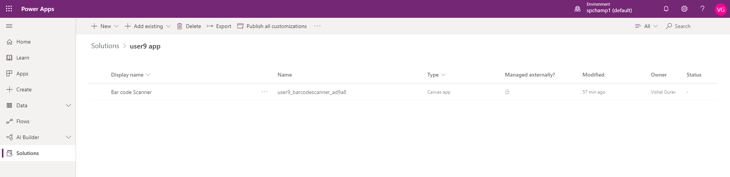
Solution
Solutions are used to transport apps and components from one environment to another
To apply a set of customizations to existing apps.
A solution can contain one or more PowerApps as well as other components such as Flow, Entities etc.

Slide 12
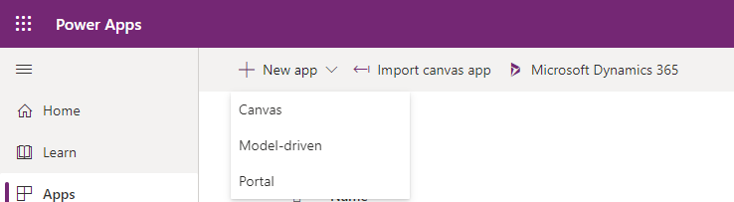
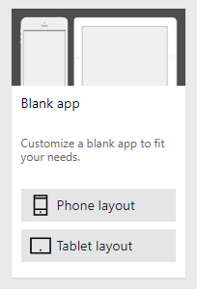
PowerApps Type and Layouts
Types
Canvas
Model-driven
Portal
Layout
Phone layout
Tablet layout

Slide 13
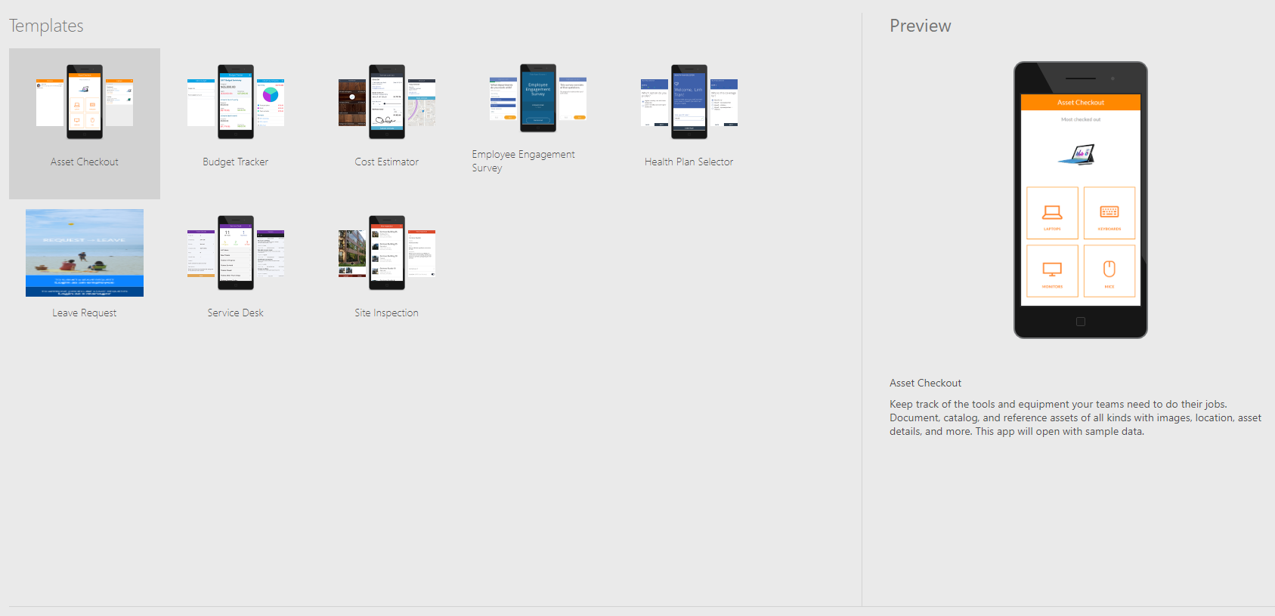
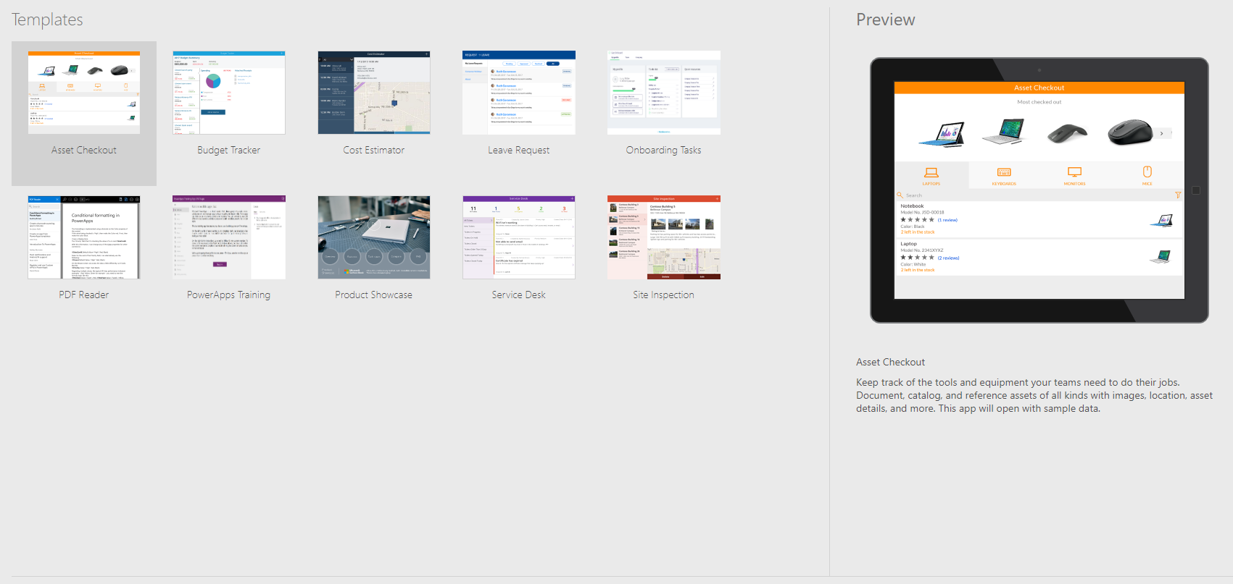
PowerApps Templates

Slide 14
Data Loss Prevention (DLP) Policies
Provides a way to protect the organization data by providing a way to enforce the DLP policies
Specific consumer connector can be configured to share a data.
Prevents important business data from being accidently published to the services such as social media.
Organizations can utilize DLP policies for better governance.
Notes:
All Connectors are not allowed by default

Slide 15
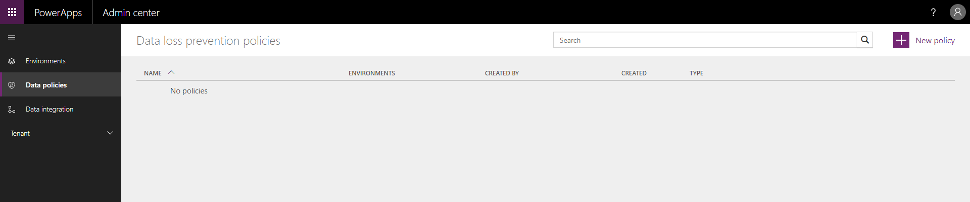
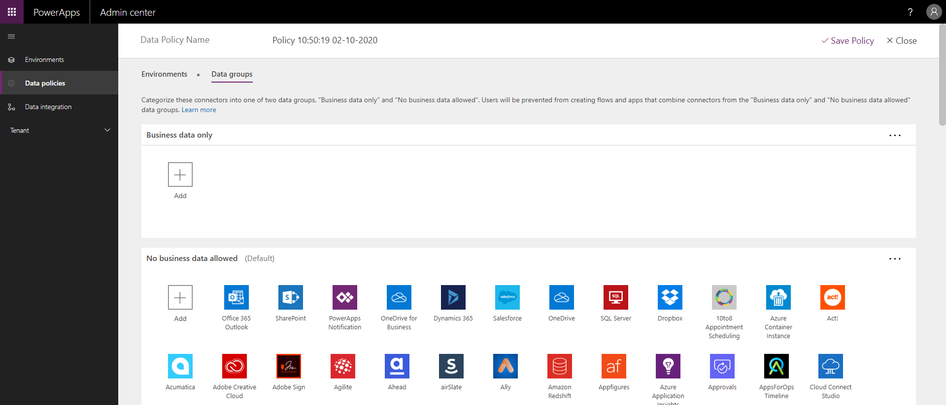
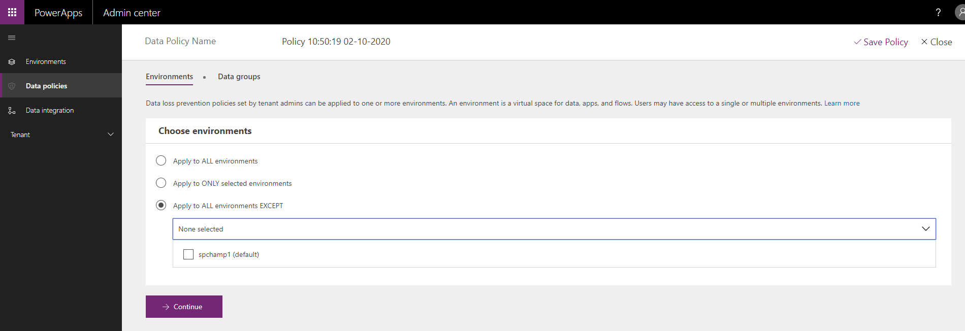
Data Loss Prevention (DLP) Policies
Notes:
All Connectors are not allowed by default

Slide 16
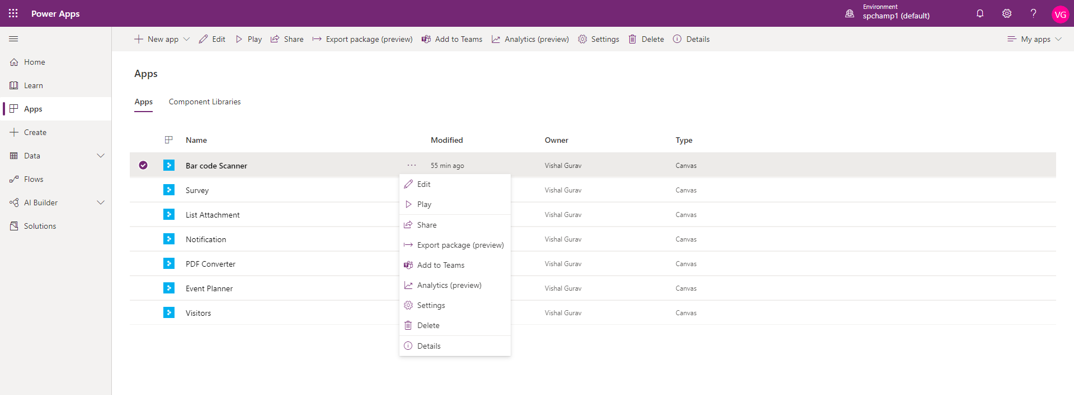
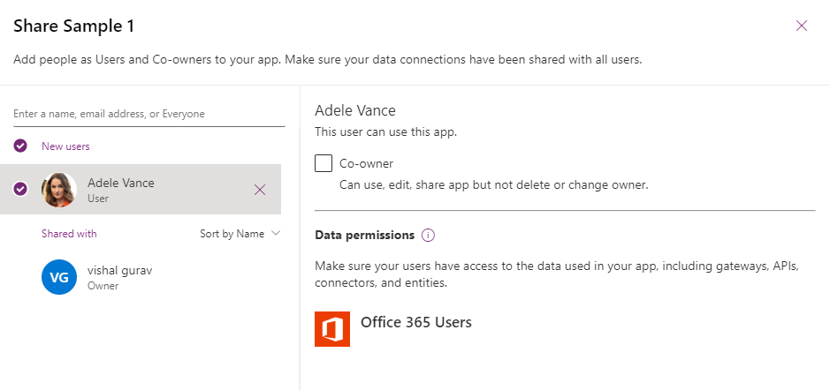
Configuring User Access
Sharing Canvas Apps
App can be shared with Users, Azure AD Groups or entire organization
App can be shared in 2 roles, Co-owner or User
Notes:
While sharing make sure you are also sharing the connections as well

Slide 17
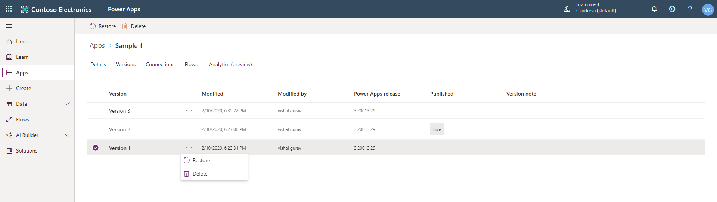
Versioning
Power Apps keeps the version history for app in cloud
It is accessible under versions tab of the app
Versioning provides restore, delete and publish actions
Notes:
While sharing make sure you are also sharing the connections as well

Slide 18

Time to grab a Goodie
What are the different types of Environments in PowerApps ?

Slide 19
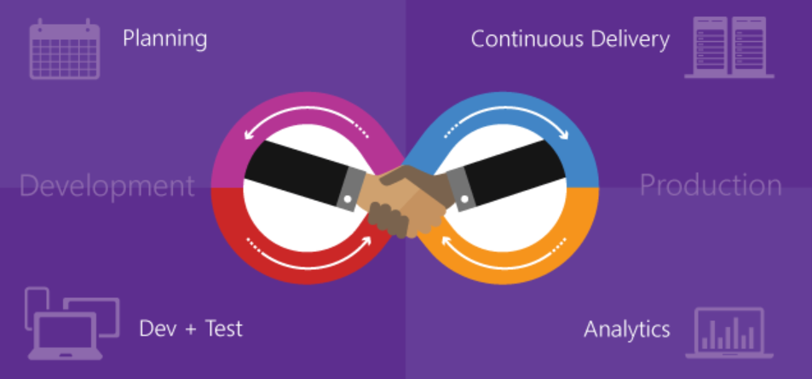
Why Application Lifecycle Management ?
Automation
Clear defined path
Speed

Slide 20
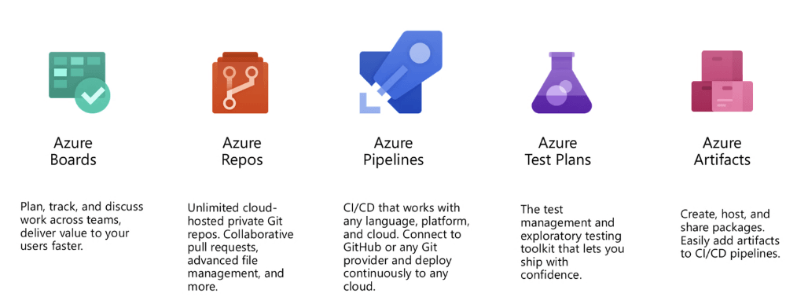
Azure DevOps

Slide 21
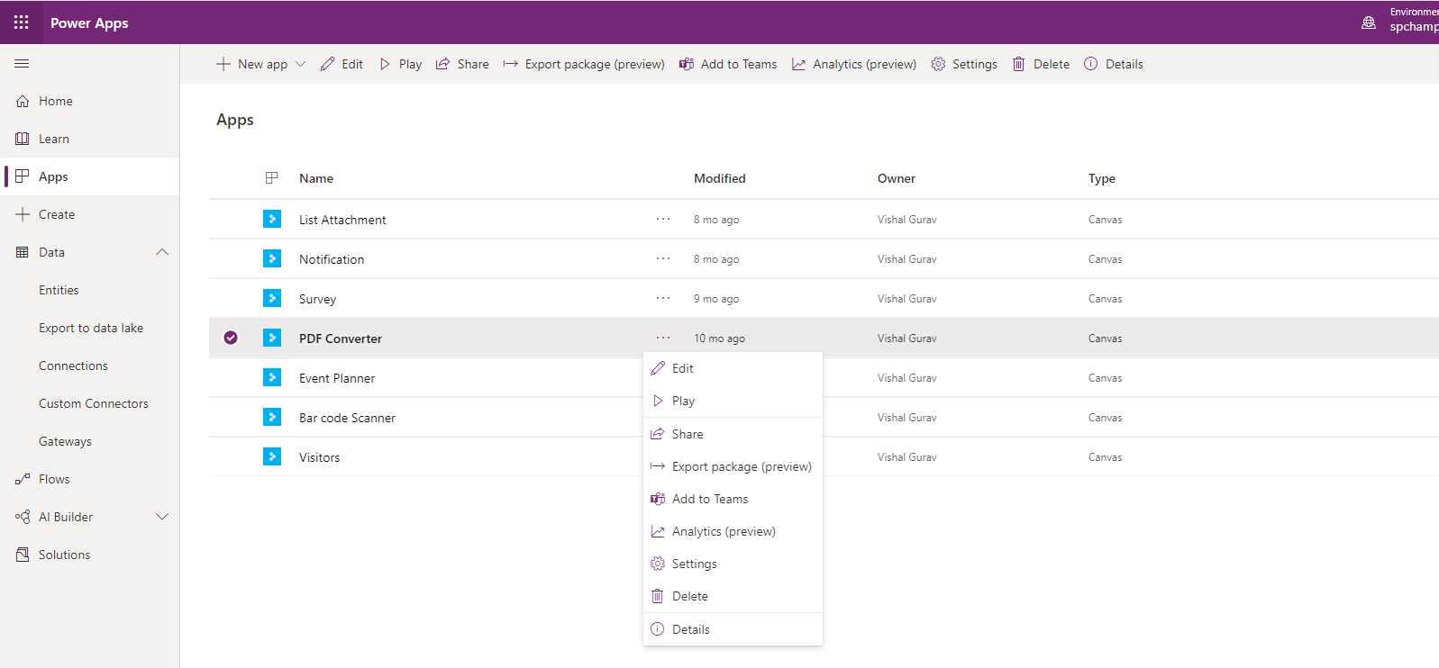
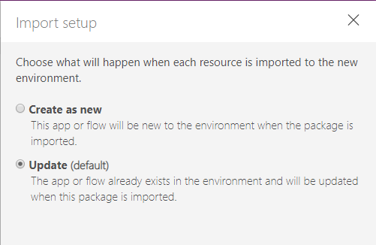
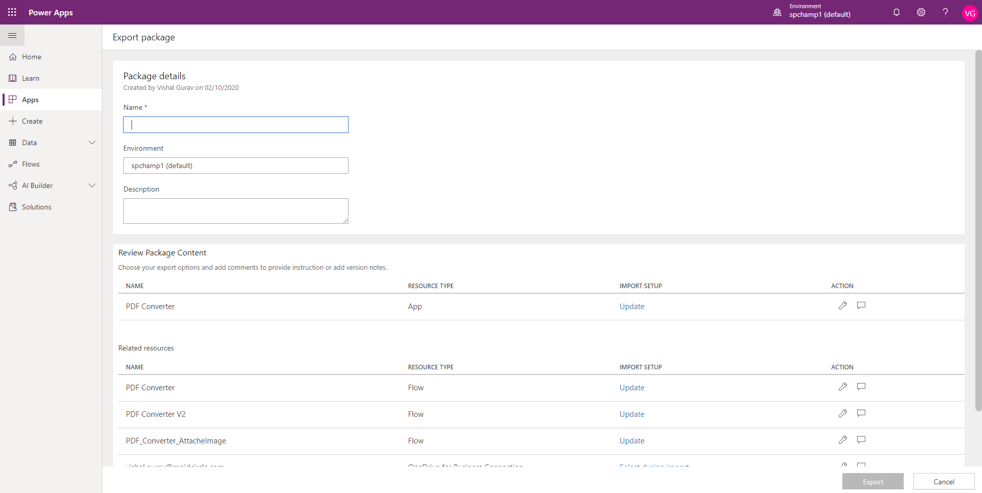
Packaging (Export)
Notes:
You can either export individual items or create a solution and then export it.

Slide 22
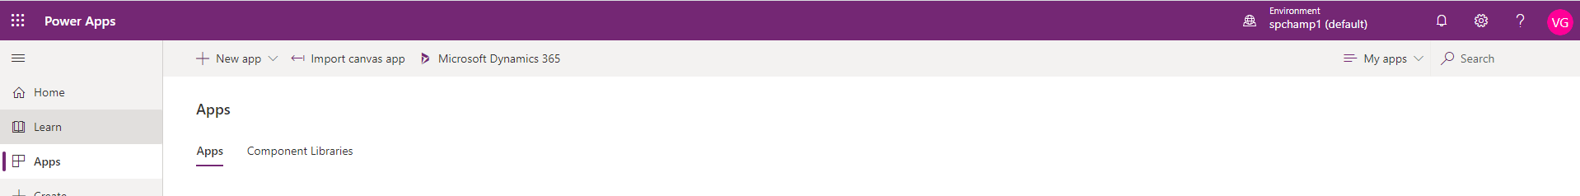
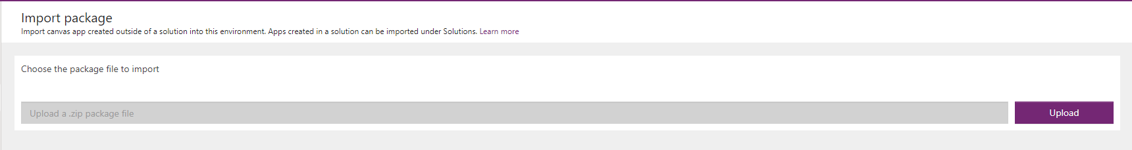
Deployment (Import)

Slide 23
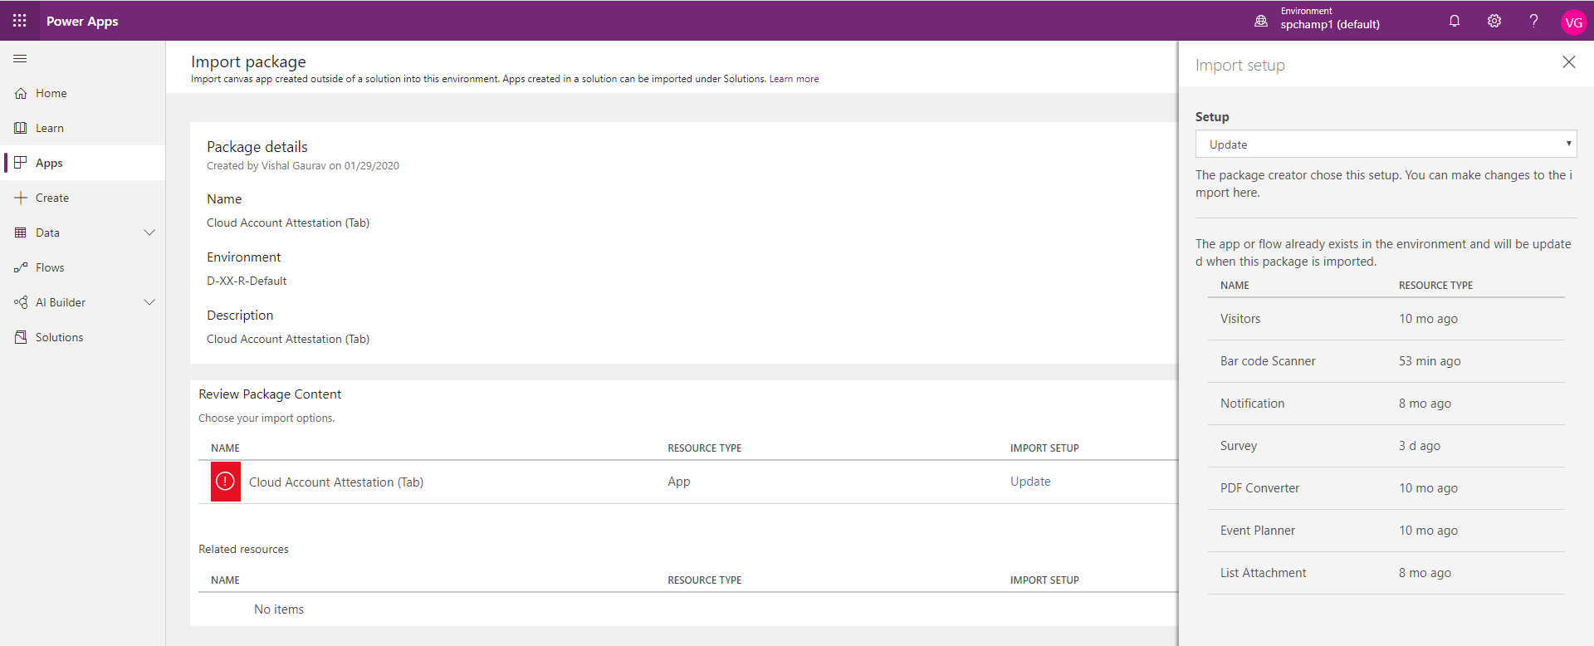
Deployment (Import)

Slide 24
Time to grab a Goodie
What is managed & unmanaged solution ?

Slide 26




Speaker Name
https://twitter.com/AnkitGirgas
https://www.linkedin.com/in/vishalgurav
https://facebook.com/ankit.girgas
https://twitter.com/vishal_gurav

